Slide 1
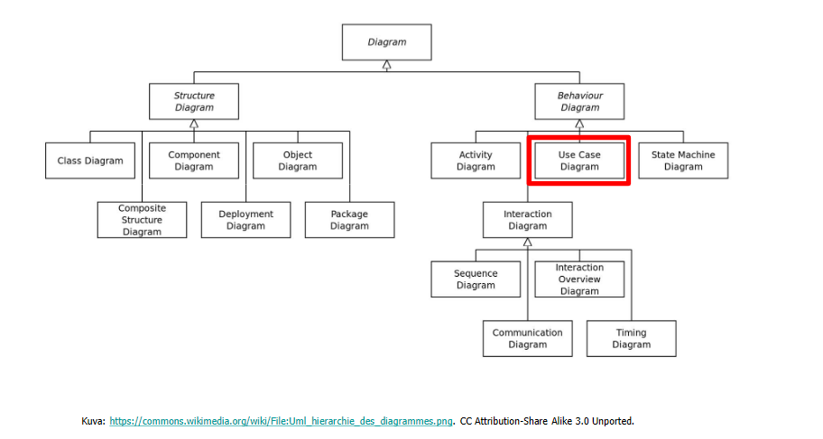
Use Case Diagram
Amir Dirin 2022

Slide 2
Use case
Use case diagram
Functional requirments
Non-functional requirements
Actor
include
Extend
Use case specification/definition/ description
Flow of events
Non-functional requirements / shadow use case

Slide 3
User Case Diagram
A diagram that shows a set of use cases and actors, and their relationships
Use cases represent system functionality the requirments of the system from user’s perspective

Slide 4

Notations
Use Case: sequence actions, including variants, that system performs that yields an observable value to an actor
Actor: The people or systems that provide or receive information from the system. The stakeholders of a system.
Include: Specifies that the source use case explicitly incorporate the behaviour of another user case at a location specified by the source
Extend: Specifies that the target use case extends the behaviour of the source.

Slide 5
Use Case Diagram
Could be human beings other systems, timers and clocks or hardware devices
The primary actors (actor).
Actors that only stimuli from the system are called secondary actors (passive)

Slide 6
Actors
Who / what will be interested in the system?
Who / what will want to change the data in the system?
Who / what will want to interface with the system?
Who / what will want information from the system?

Slide 7
Exercise
Create a use diagram which describe the relations of actors and actions.
A resturant have different actors for example,
Waiter, Client, Cashier, abd Chef

Slide 8
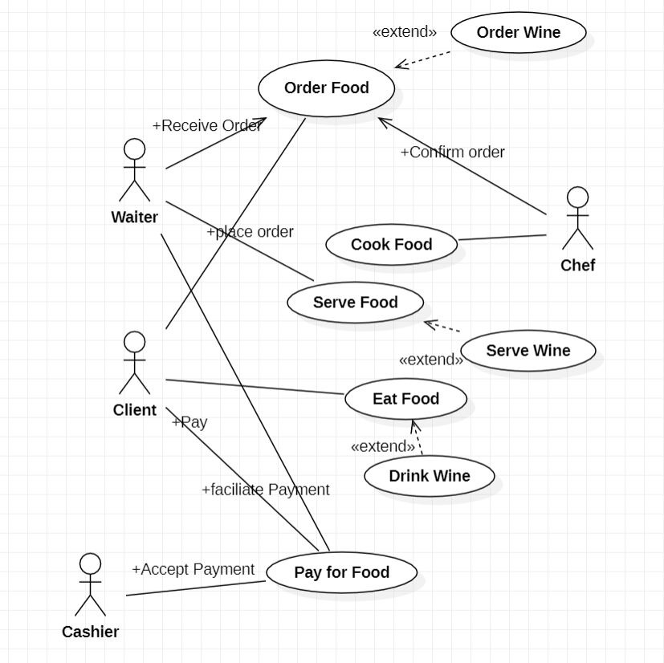
Answer

Slide 9
Exercise 2
Create a use case diagram for web for library managment system at university
Actors:
Users (Student, Staff)
Liberian
Database

Slide 10
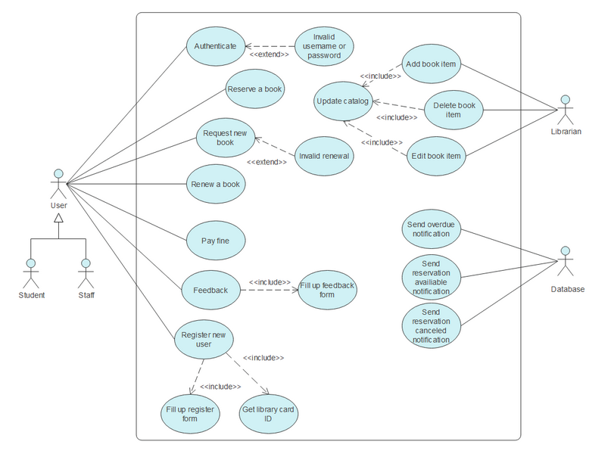
Answer

